Slide 1

VanDurga
- An A.I. Based Real Time Fire Detection System
Submitted By:-
BT21CSE016 Harisharan
BT21CSE023 Divyansh Asthana
BT21CSE029 Harshit Pokhriyal
Submitted To:
Mrs. Neha Sharma
Department of Computer Science And Engineering

Slide 2
OBJECTIVE
REQUIREMENTS
DATA COLLECTION
MACHINE LEARNING TECHNIQUES
EVALUATION METRICS
RESULTS AND DISCUSSIONS
CONCLUSION
REFERENCES
OUTLINE:

Slide 3
Objective

Slide 4

The Objective
TO CREATE A FIRE DETECTION AND MONITORING SOFTWARE USING MACHINE LEARNING TECHNIQUES WHICH WORKS ON LIVE FEED.
TO DEPLOY THE MODEL WITH FRONT END.

Slide 5
Requirements
The developed software should be able to:
correctly classify if a fire is present in the frame or not.
detect the location the fire in the frame.
run on a video input.
deployed with frontend.

Slide 6
Data Collection

Slide 7
Data Collection:
Data collection was performed through various methods. The methods used in the development of this project were:
Web Scraping
Data Annotation
Using Pre-Existing Datasets

Slide 8
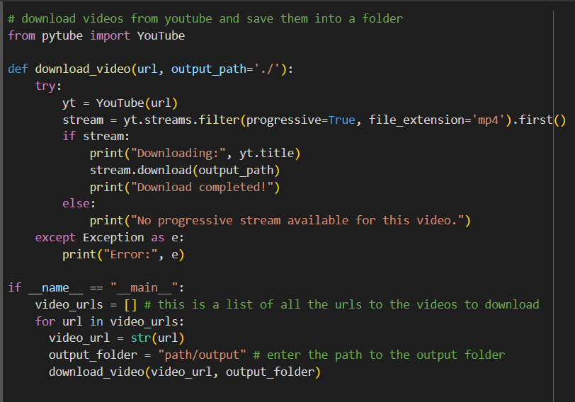
Web Scraping:
Web Scraping is a technique where dataset is created by downloading the images and other information relevant to the dataset from the internet.
We used a library called PyTube which helps download videos from youtube.
Provided below is a code snippet for the same:

Slide 9
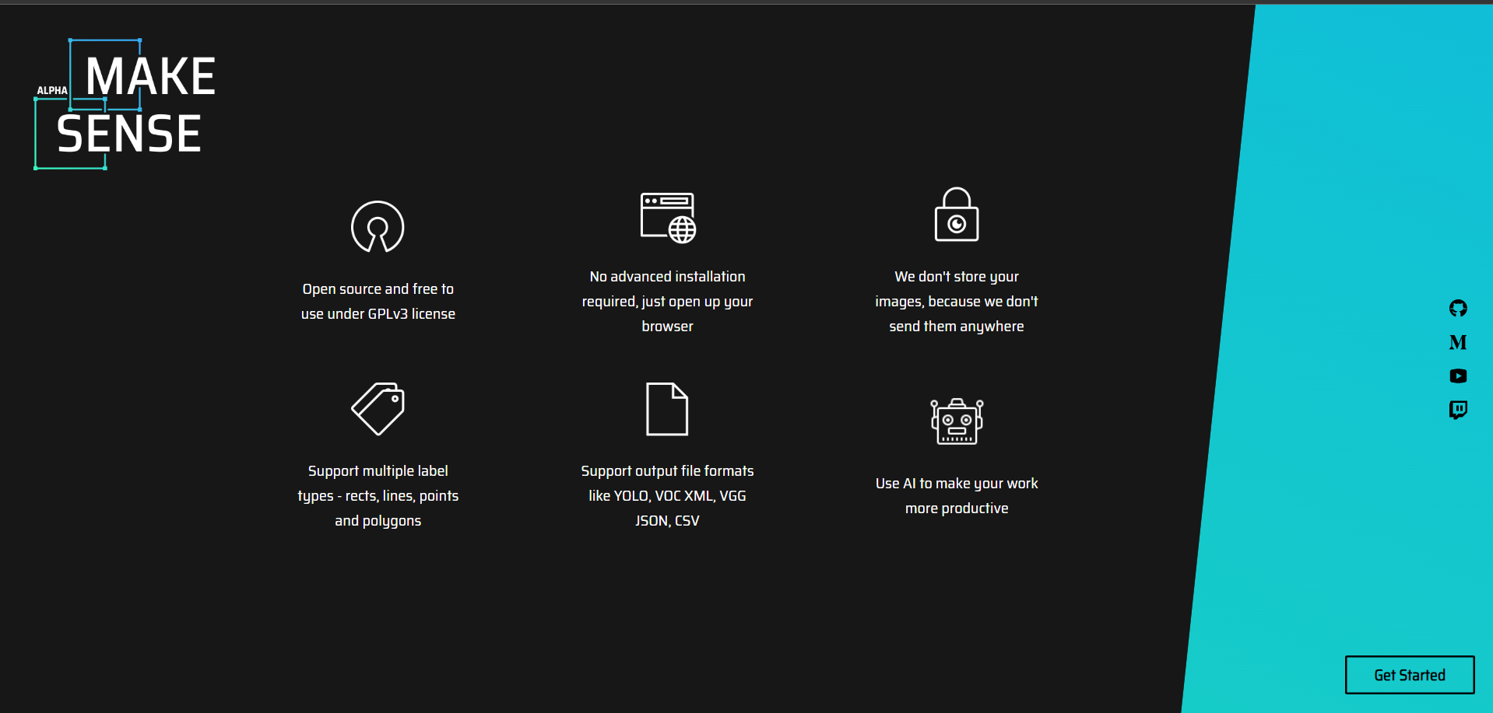

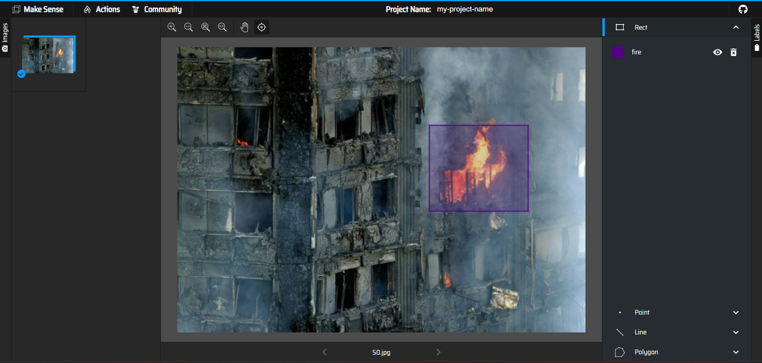
Data Annotation:
Data Annotation is a technique where dataset is created by downloading the images and other information relevant to the dataset from the internet and then performing annotations with the labels on the provided dataset. This can be done using Makesense.ai
This is an important step in data collection as this is the logic on which the model will be trained.

Slide 10
Pre-Existing Datasets:
Pre-existing datasets can be used to make the task easier and get a clean dataset. This technique is especially useful when there is a lack of resources and manpower. The only caveat is that the source should be a trustworthy source.
There are many such sources. We primarily used datasets from the following sources:
Roboflow
Kaggle

Slide 11
The Machine Learning Techniques

Slide 12
Machine Learning Techniques:
The ML techniques used in the development of this software are:
Convolutional Neural Networks (CNN):
ResNet50
Gated Recurrent Unit (GRU)
ResNet50 + GRU
YOLOv8

Slide 13
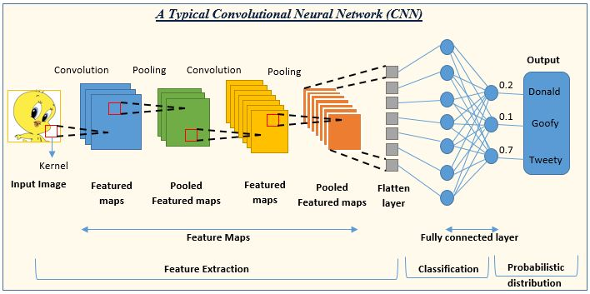
Convolutional Neural Networks:
Convolutional Neural Networks (CNNs) are specialized artificial neural networks designed for computer vision tasks like image classification, object detection, and segmentation. They operate through several key stages:
Convolution: CNNs apply convolutional filters to input images to detect specific features like edges, textures, or shapes. This involves sliding filters across the image and computing dot products to generate feature maps highlighting relevant features.
Activation: Following convolution, an activation function, often ReLU, is applied to introduce non-linearity, capturing complex patterns.
Pooling: Pooling layers like max or average pooling reduce feature map dimensions while retaining crucial information, making learned features more robust and decreasing computational complexity.

Slide 14
Convolutional Neural Networks:
Flattening: The pooled feature maps are then flattened into a 1D vector. This step prepares the data for input into the fully connected layers.
Fully Connected Layers: The flattened features are passed through one or more fully connected layers, also known as dense layers. These layers perform high-level reasoning and decision-making based on the learned features. Each neuron in a fully connected layer is connected to every neuron in the previous layer.
Output Layer: The output layer typically consists of one or more neurons, depending on the number of classes in the classification problem. For example, in a binary classification problem, there would be a single neuron with a sigmoid activation function. For multi-class classification, there would be multiple neurons, often with a softmax activation function. The output of the network represents the predicted class probabilities for each input image.

Slide 15
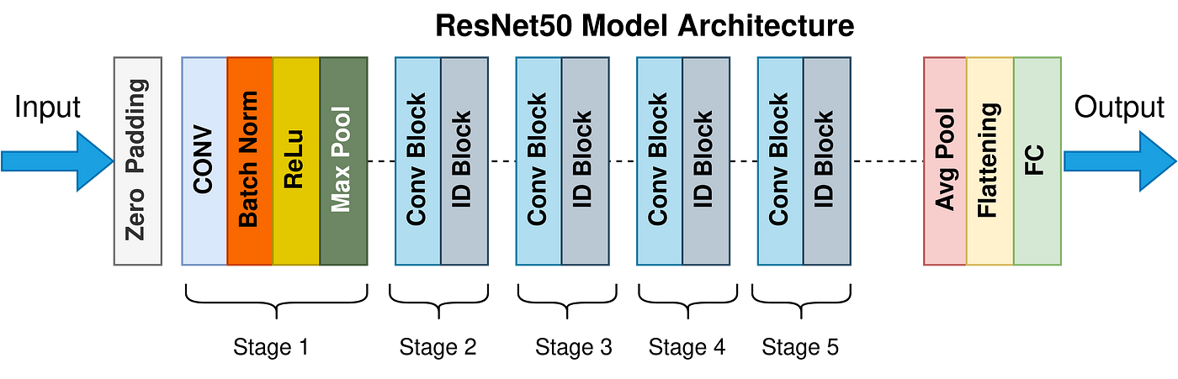
ResNet 50:
ResNet-50 is a deep convolutional neural network renowned for image classification. It addresses the vanishing gradient problem with residual learning via skip connections, facilitating effective training of deep networks. The architecture includes convolutional layers, residual blocks for feature extraction, and pooling layers for dimensionality reduction. Fully connected layers perform high-level reasoning, followed by a sigmoid activation for binary classification. Training employs backpropagation and optimization algorithms like stochastic gradient descent or Adam to adjust parameters iteratively. With its ability to learn intricate features and mitigate gradient vanishing, ResNet-50 achieves high accuracy in image classification tasks, making it a widely used and effective model in the field.
Main Components of ResNet-50:
Input Layer
Convolutional Layers
Residual Blocks
Identity Block
Convolutional Block
Pooling Layers
Fully Connected Layers
Sigmoid Activation
Training and Optimization

Slide 16
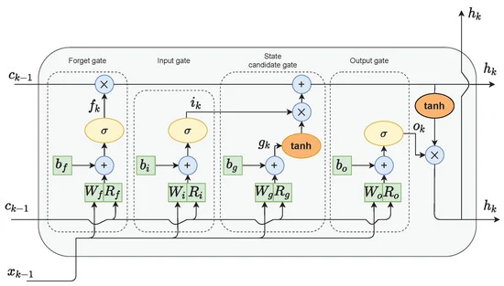
Gated Recurrent Unit (GRU - RNN)
The Gated Recurrent Unit (GRU) is a variant of recurrent neural networks (RNNs) designed to address limitations like vanishing gradients and difficulty in capturing long-term dependencies. Unlike traditional RNNs, GRUs incorporate gating mechanisms to regulate information flow within the network, offering computational efficiency without sacrificing effectiveness.
Update Gate: Determines how much of the previous hidden state should be retained for future use based on the current input and previous state.
Reset Gate: Controls how much of the past information should be discarded, similarly based on the current input and previous state.

Slide 17
Gated Recurrent Unit (GRU - RNN)
Candidate Hidden State: Computes a new candidate hidden state by integrating relevant information from the current input and previous hidden state.
Hidden State: The final hidden state is calculated by blending the candidate hidden state with the previous hidden state, modulated by the update gate.
GRUs excel at capturing long-term dependencies in sequential data by selectively retaining or discarding information from past time steps. This mechanism ensures efficient information processing while mitigating the vanishing gradient problem often encountered in traditional RNNs.

Slide 18
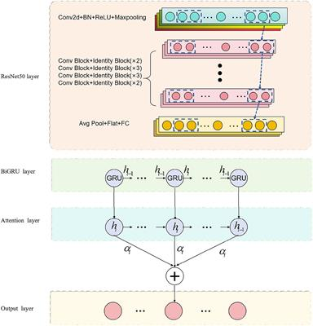
ResNet50 + GRU architecture
In a video classification setup, ResNet-50 extracts spatial features from each frame, creating high-level feature vectors.
These vectors are then fed into a GRU, which models temporal dependencies between consecutive frames.
The GRU's final hidden state encapsulates the video's temporal information. This state is forwarded to fully connected layers for classification, yielding class probabilities via softmax.
Training involves end-to-end optimization of both ResNet-50 and the GRU using labeled video data. During inference, unseen videos undergo frame-wise processing, with final classification determined by the output of the classification layers, leveraging learned spatial and temporal features.

Slide 19

YOLOv8
YOLO (You Only Look Once) is a popular object detection algorithm known for its speed and accuracy. It works by dividing the input image into a grid and predicting bounding boxes and class probabilities directly from the grid cells.
YOLOv8 is packed with several powerful features that make it an exceptional choice for object detection tasks. Whether you need to utilize pre-trained models or create custom models for specific object types, YOLOv8 offers an array of capabilities to cater to your requirements. Let's explore these key features in detail:
Main Features of YOLOv8:
Pre-trained Models
Custom Models
Data Preparation
Web Application Support
YOLOv8 can perform Objection detection, Classification , Segmentation and Pose - Tracking

Slide 20
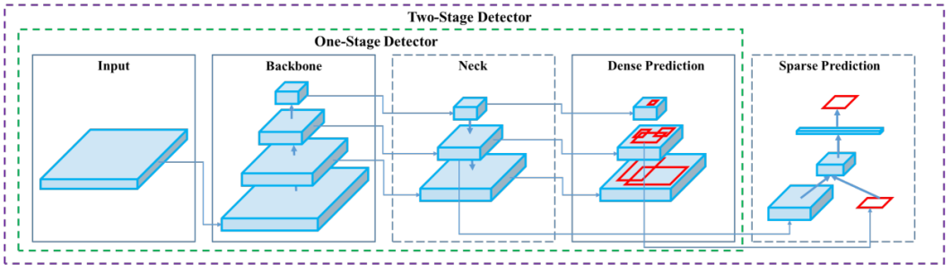
YOLOv8
YOLO (You Only Look Once) is an object detection algorithm known for its speed and accuracy. Its operation can be broken down into several key steps:
Input Image: YOLO takes an input image of any size.
Grid Division: The image is divided into an SxS grid, with each cell responsible for predicting objects whose centers fall within it.
Bounding Box Prediction: Each grid cell predicts bounding boxes, including their coordinates, dimensions, and confidence scores.Class Prediction: Each grid cell also predicts conditional class probabilities for detected objects, using softmax activation to ensure probabilities sum up to 1.

Slide 21
YOLOv8
Final Output:The output is a tensor containing all bounding box predictions and class probabilities.
Non-Maximum Suppression (NMS): YOLO applies NMS to remove duplicate detections and retain the most confident ones.
Thresholding: A confidence score threshold is applied to filter out low-confidence predictions.
Post-Processing: After NMS and thresholding, remaining detections are considered final.
YOLO's real-time capabilities suit applications like autonomous driving and video surveillance. Its single-pass architecture simultaneously predicts bounding boxes and class probabilities, ensuring efficiency in object detection tasks. With its speed and accuracy, YOLO offers robust performance for various real-world applications.

Slide 22
Evaluation Metrics

Slide 23

Evaluation Metrics: Training Accuracy vs Validation Accuracy in ResNet50 + GRU
The plots of train accuracy vs. validation accuracy and train loss vs. validation loss are crucial tools for analyzing and understanding the performance of a machine learning model during training. These plots provide valuable insights into how well the model is learning from the training data and generalizing to unseen data.
Overfitting and Underfitting Detection:
Overfitting occurs when a model learns to memorize the training data too well, leading to poor generalization to unseen data. This is often characterized by a significant gap between the training and validation performance metrics.

Slide 24
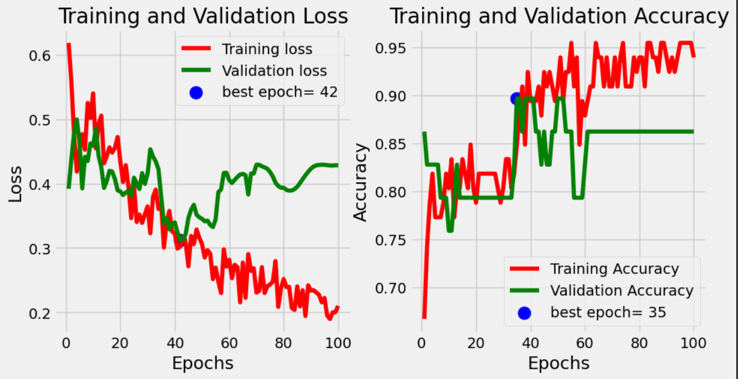
Evaluation Metrics: Training Accuracy vs Validation Accuracy in ResNet50 + GRU
The plots of train accuracy vs. validation accuracy and train loss vs. validation loss can help identify overfitting by observing if the validation metrics start to degrade while the training metrics continue to improve.
Similarly, underfitting occurs when a model is too simple to capture the underlying patterns in the data, resulting in poor performance on both training and validation data. This is reflected in consistently low accuracy and high loss values for both training and validation sets.

Slide 25
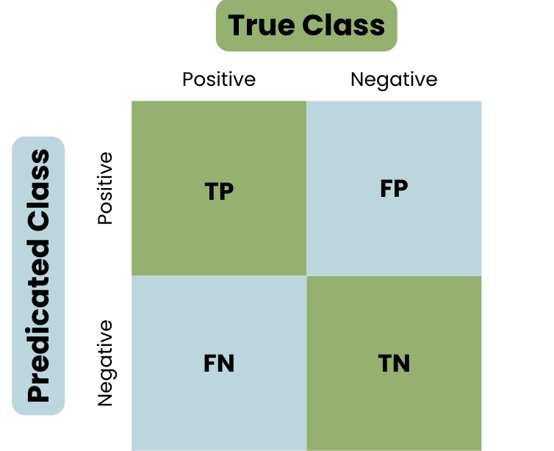
Evaluation Metrics: Confusion Matrix
A confusion matrix is a table that is often used to describe the performance of a classification model on a set of test data for which the true values are known. It allows visualization of the performance of an algorithm and helps to understand how well the algorithm is performing in terms of different metrics.
True Positives (TP): These are the cases where the model correctly predicts the positive class. For example, if the actual class is positive (1) and the model also predicts it as positive, it's a true positive.
True Negatives (TN): These are the cases where the model correctly predicts the negative class. For example, if the actual class is negative (0) and the model also predicts it as negative, it's a true negative.
False Positives (FP): These are the cases where the model incorrectly predicts the positive class. For example, if the actual class is negative (0) but the model predicts it as positive (1), it's a false positive. Also known as Type I error.
False Negatives (FN): These are the cases where the model incorrectly predicts the negative class. For example, if the actual class is positive (1) but the model predicts it as negative (0), it's a false negative. Also known as Type II error.

Slide 26
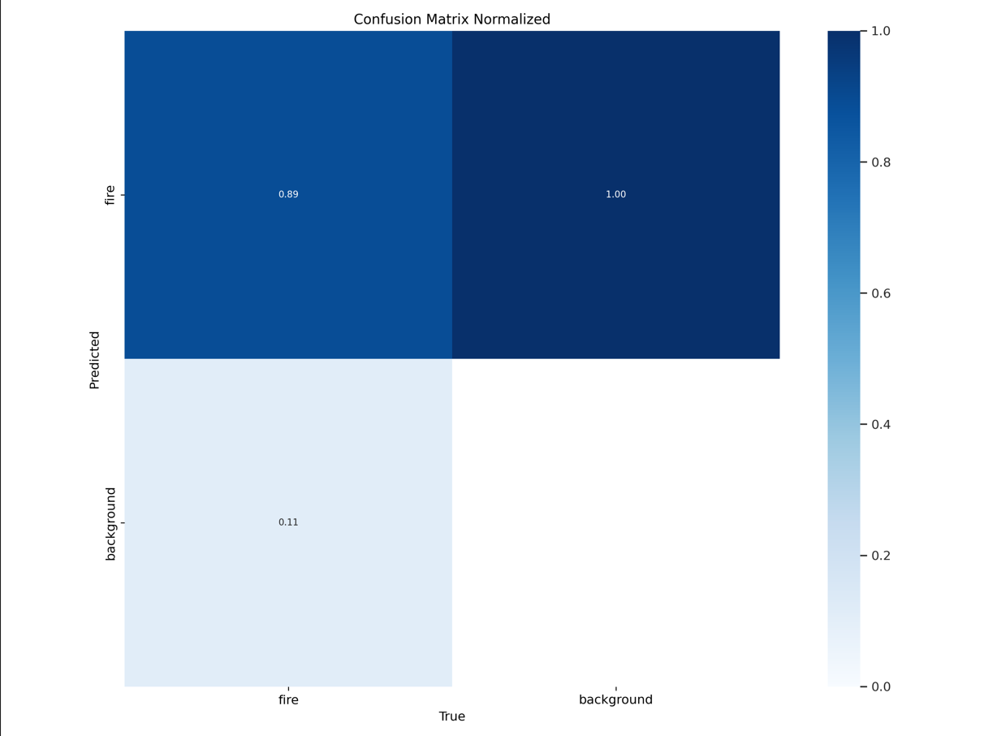
Evaluation Metrics: Confusion Matrix ResNet50
Using these values, various performance metrics can be calculated, including:
Accuracy: The proportion of correctly classified instances (TP + TN) among the total instances.
Precision: The proportion of true positive predictions among all positive predictions (TP / (TP + FP)).
Recall (Sensitivity): The proportion of true positive predictions among all actual positive instances (TP / (TP + FN)).
Specificity: The proportion of true negative predictions among all actual negative instances (TN / (TN + FP)).
F1 Score: The harmonic mean of precision and recall, balancing between the two metrics

Slide 27
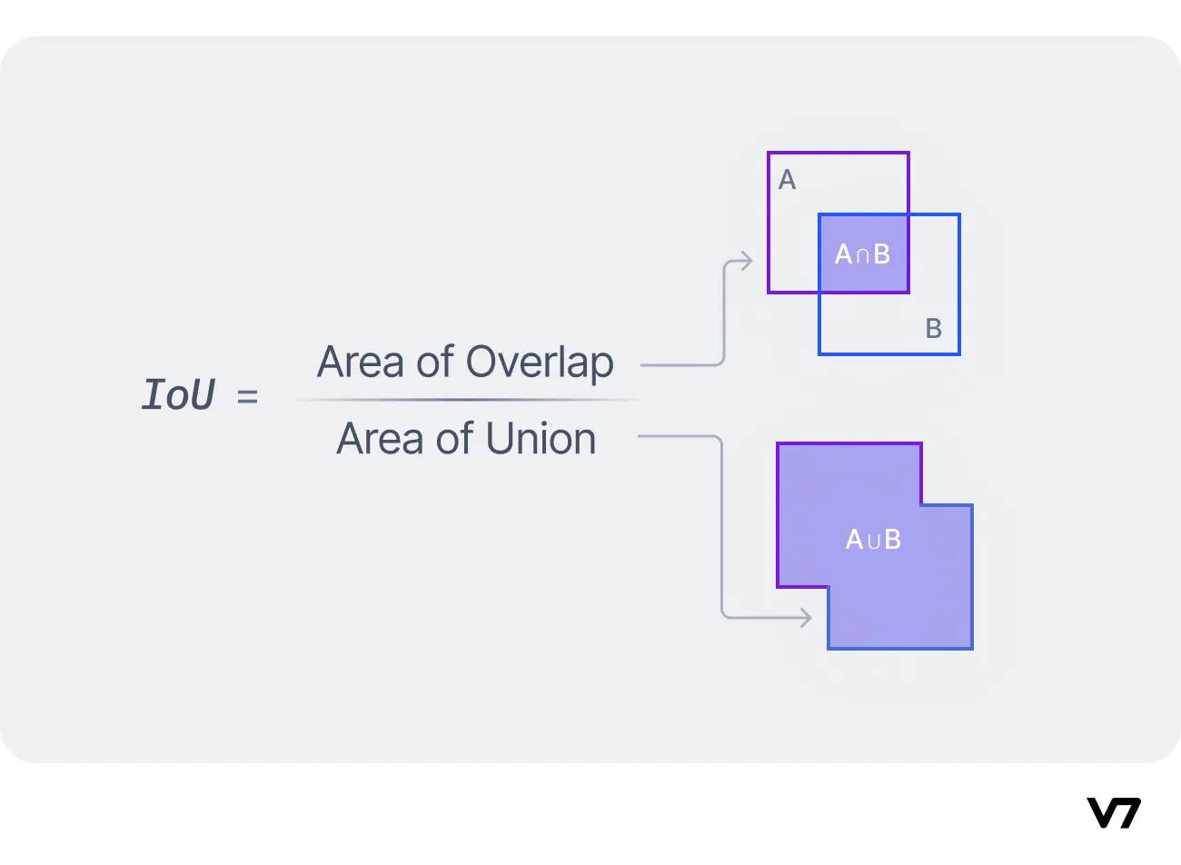
Evaluation Metrics: IoU YOLOv8
Intersection over Union (IoU) measures the overlap between predicted and ground truth bounding boxes.
mAP50: Mean Average Precision at IoU threshold of 50%, evaluates object detection accuracy considering overlapping areas between predicted and ground truth boxes.
mAP50-95: Mean Average Precision over IoU thresholds from 50% to 95%, provides a broader evaluation of object detection performance.

Slide 28
Results And Discussions

Slide 29
Results
ResNet50 + GRU:
Training Accuracy: 94.6%
Validation Accuracy: 86%
Testing Accuracy: 62.5%
Precision: 0.472
Recall: 0.893
YOLOv8:
mAP50: 89.6%
mAP50-95: 65.8%
Precision: 0.897
Recall: 0.795

Slide 30
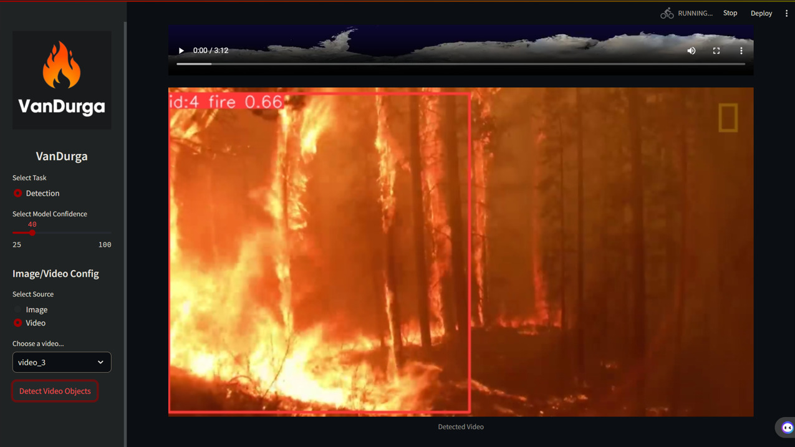
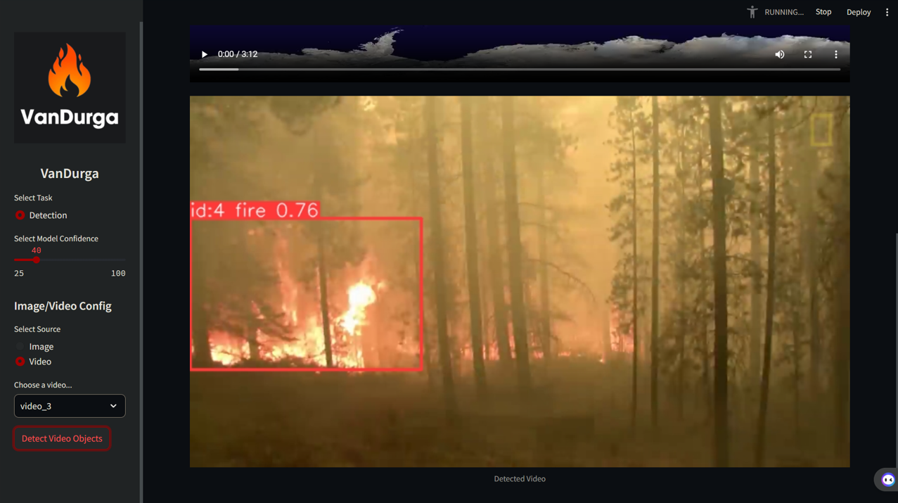
Results

Slide 31
Discussions
Using YOLOv8 for forest fire detection offers several advantages. YOLOv8 is a state-of-the-art object detection model known for its speed and accuracy, making it suitable for real-time applications like fire detection in forests. Here's a brief discussion:
1. High Accuracy
2. Real-time Performance
3. Robustness to Environmental Factors
4. Scalability
5. Integration with Monitoring Systems
6. Early Warning System
Overall, employing YOLOv8 for forest fire detection enhances the efficiency and effectiveness of monitoring efforts, contributing to better forest management and fire prevention strategies.

Slide 32
Conclusion

Slide 33
Conclusion
Fire detection in forests has always been an important and tedious task which has shown a high human error rate when given to diagnose. With the advancing technology in AI/ML we hope to provide an automated solution to the existing problem.
Further improvements in data processing, data collection, machine learning models and algorithms would surely make this software feasible and accurate for real time use.

